Slide 1
EECE-165
Basic Electrical Technology
References
1. A textbook of Electrical Technology (Vol.II)
-B. L. Theraja
2. Electronic Devices & Circuit Theory-R.L.
Boylstad

Slide 2
Introduction to Electrical
Engineering

Slide 3
WELCOME TO THE LECTURE
ON DC GENERATOR

Slide 4
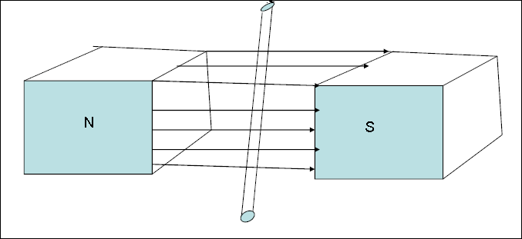
Faraday’s law of Electromagnetic
Induction
• A voltage is induced in a conductor if the
conductor cuts lines of magnetic flux.

Slide 5
Lenz’s Law
• When a conductor is moved through a
magnetic fields a voltage is induced in the
conductor .If the circuit is closed, the induced
voltage will cause a current flow. The
magnetic field produced by the current will
always oppose the motion of the conductor.

Slide 6
DC Generators
• An electrical Generator is a machine which converts
mechanical energy (or power) into electrical energy (or
power).
• Principle :
It is based on the principle of production of dynamically (or
motionally) induced e.m.f (Electromotive Force). Whenever a
conductor cuts magnetic flux, dynamically induced e.m.f. is
produced in it according to Faraday's Laws of Electromagnetic
Induction. This e.m.f. causes a current to flow if the conductor
circuit is closed.
Hence, the basic essential parts of an electric generator are :
• A magnetic field and
• A conductor or conductors which can so move as
to cut the flux.

Slide 7
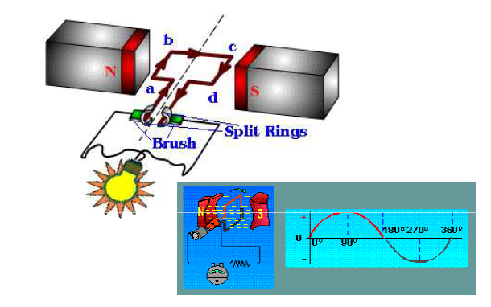
• A single-turn rectangular copper coil abcd moving about its own axis in a
magnetic field provided by either permanent magnets or electromagnets. The
two ends of the coil are joined to two split-rings which are insulated from each
other and from the central shaft. Two collecting brushes (of carbon or copper)
press against the slip rings.

Slide 8
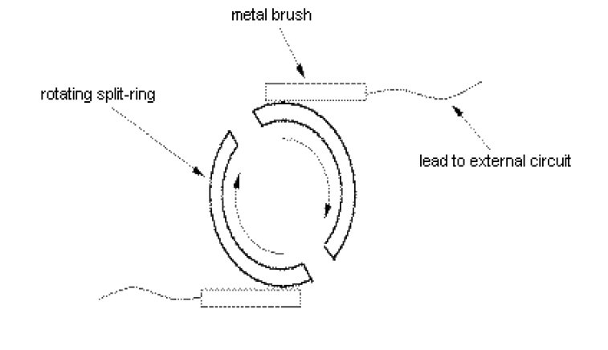
Split ring

Slide 9
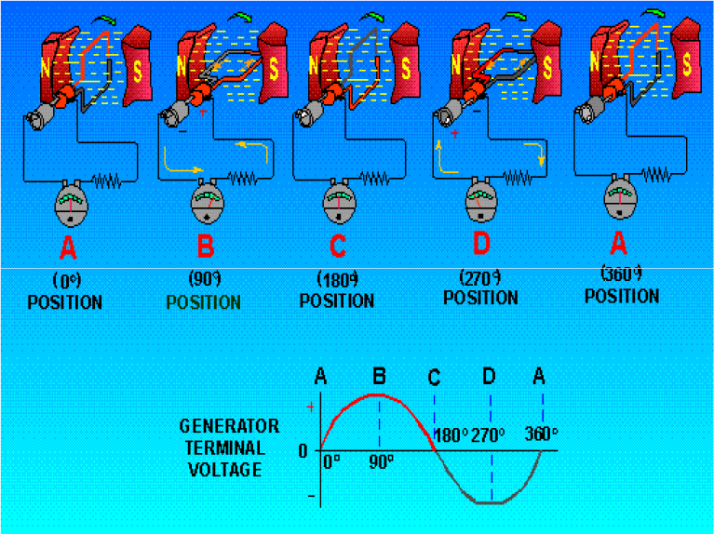

Slide 10
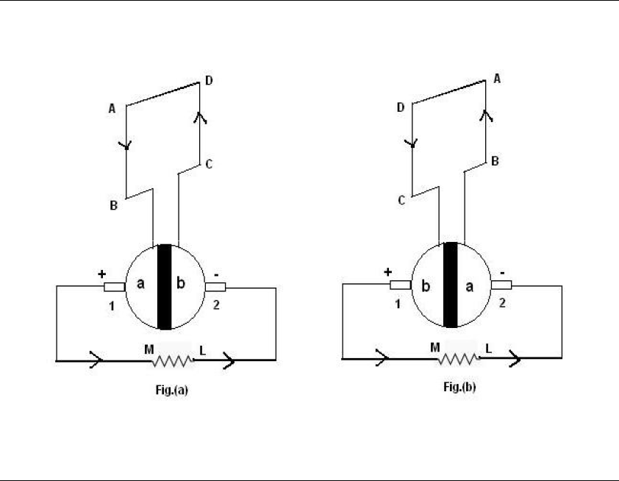

Slide 11
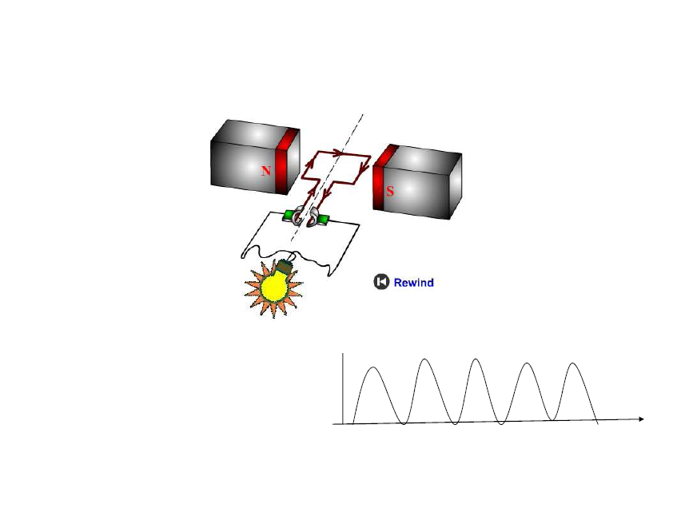

Slide 12
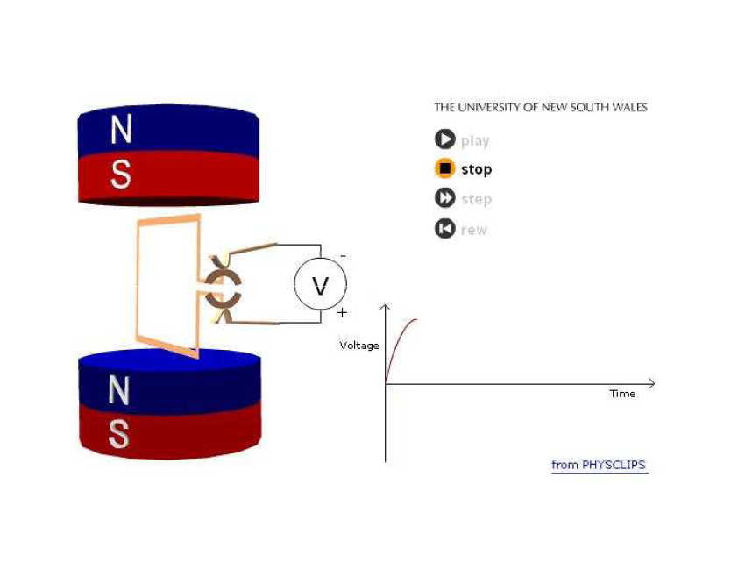

Slide 13
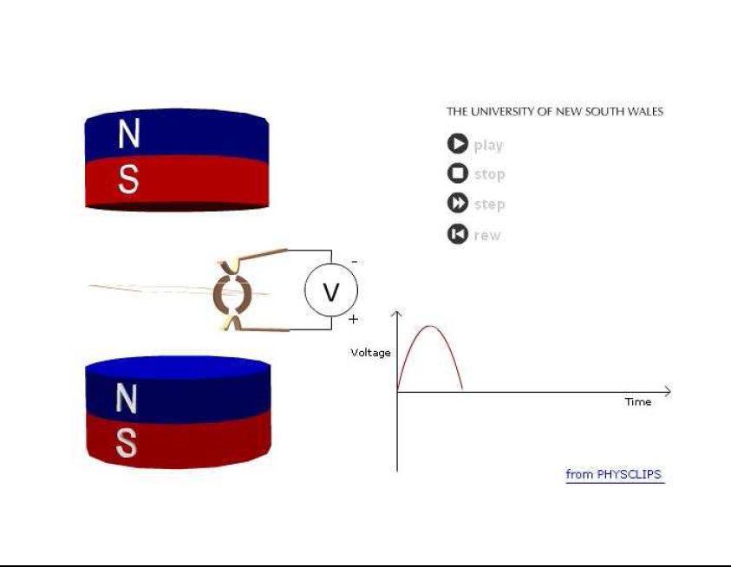

Slide 14
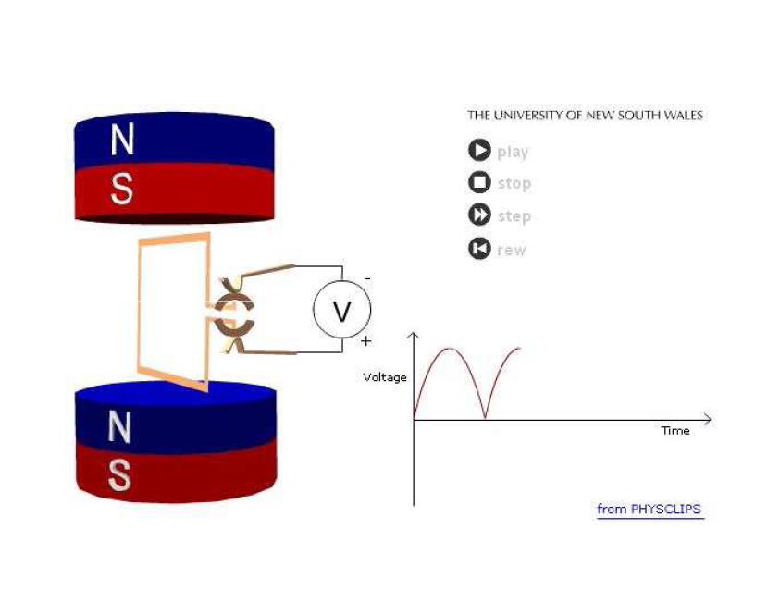

Slide 15
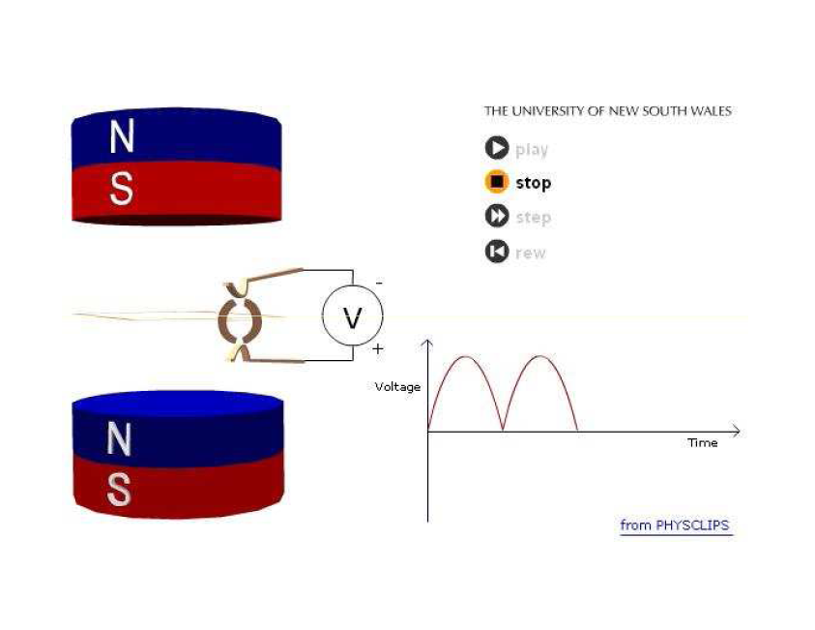

Slide 16
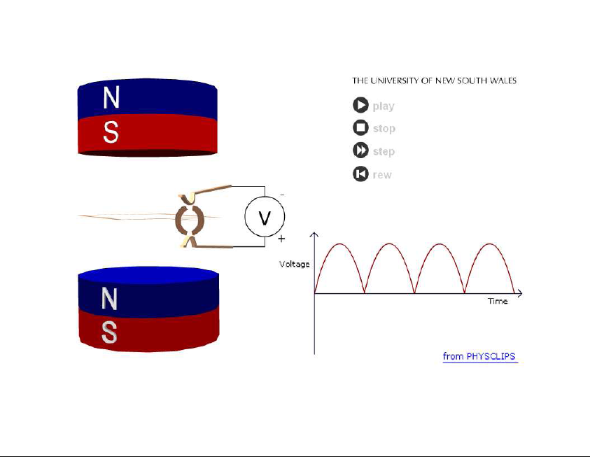

Slide 17
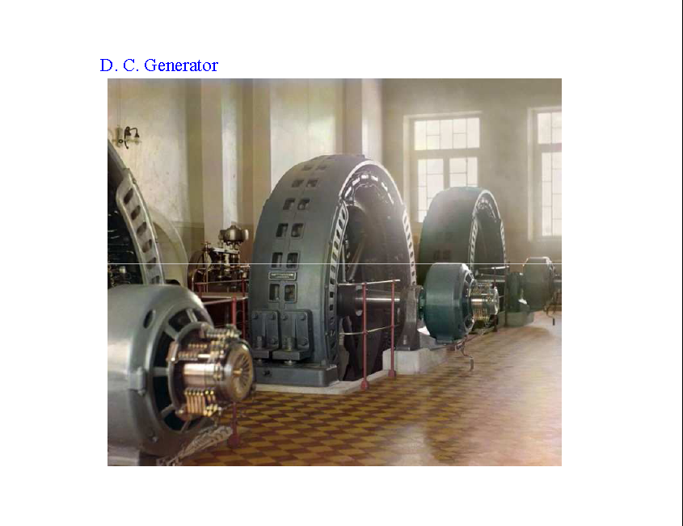

Slide 18
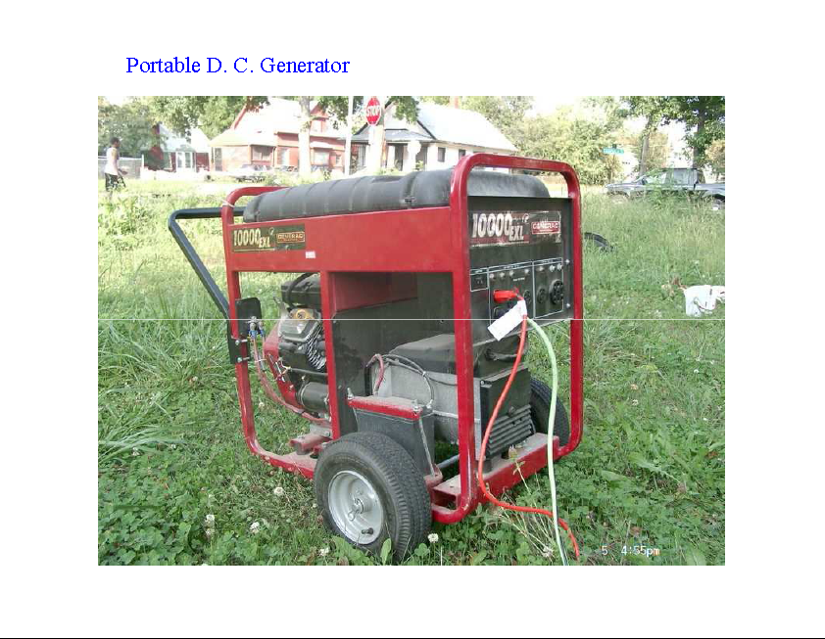

Slide 19
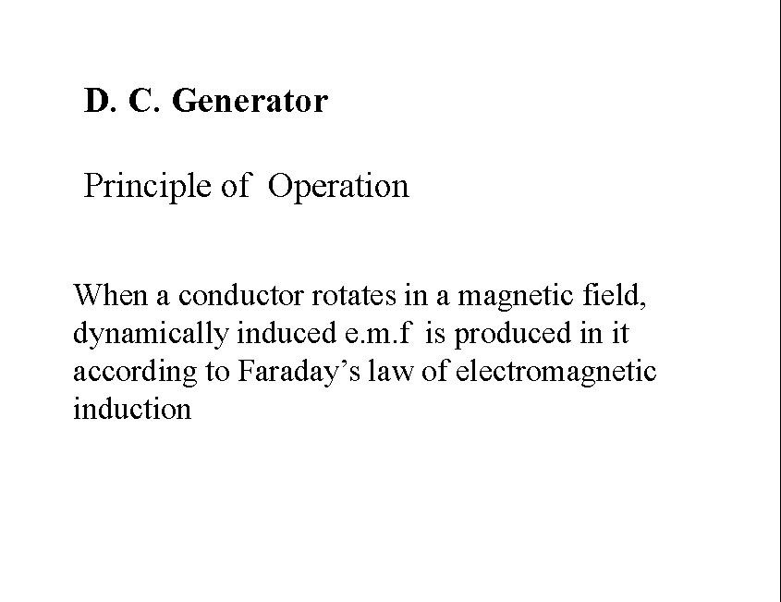

Slide 20
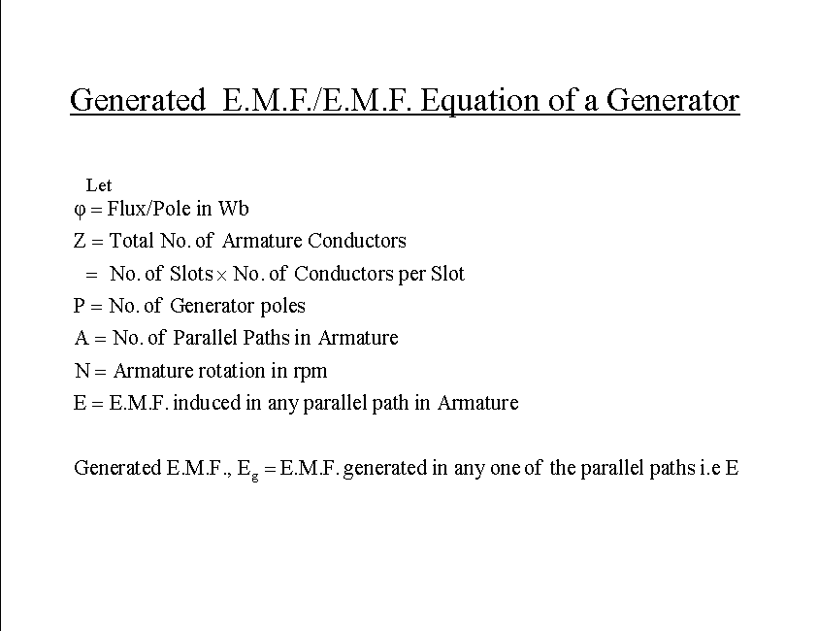

Slide 21
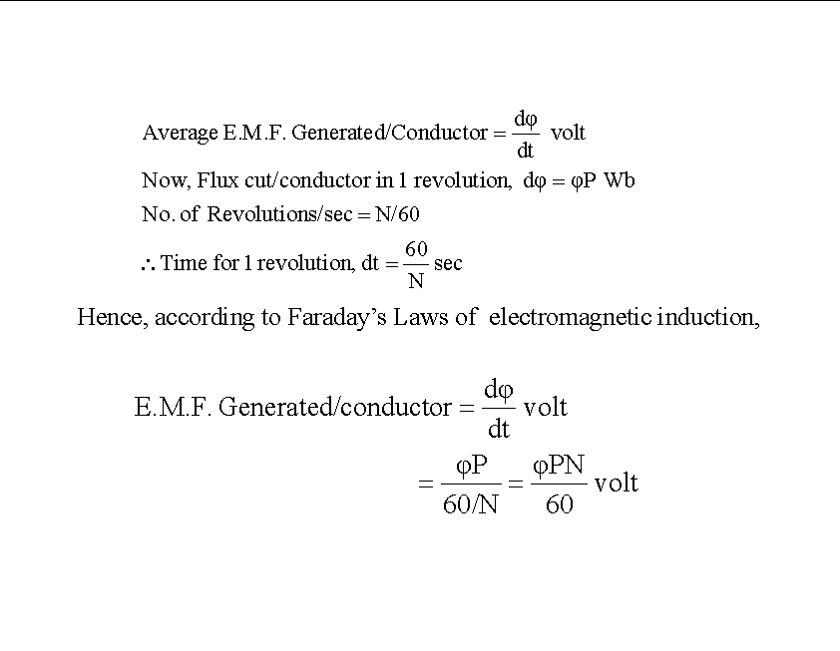

Slide 22
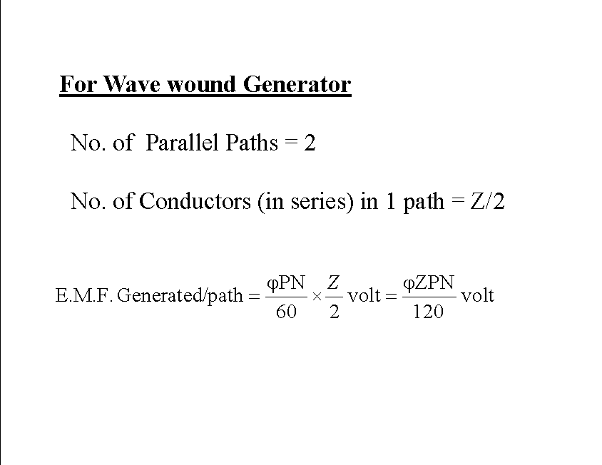

Slide 23
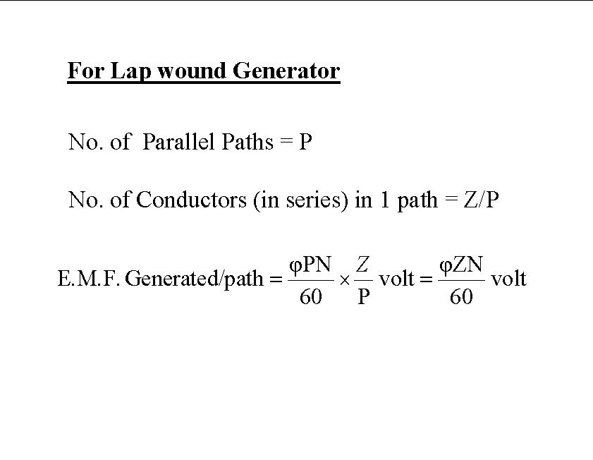

Slide 24
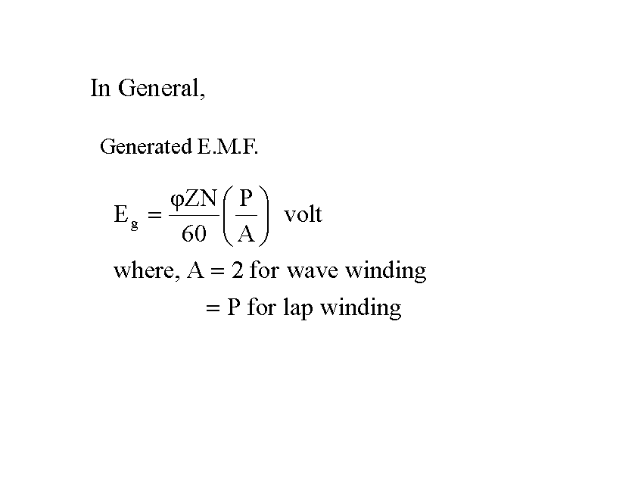

Slide 25
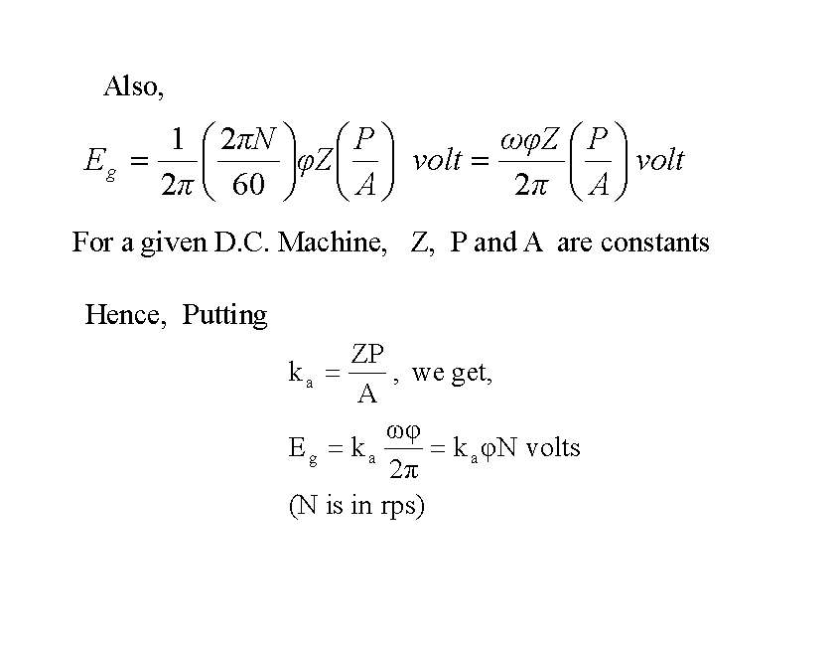

Slide 26
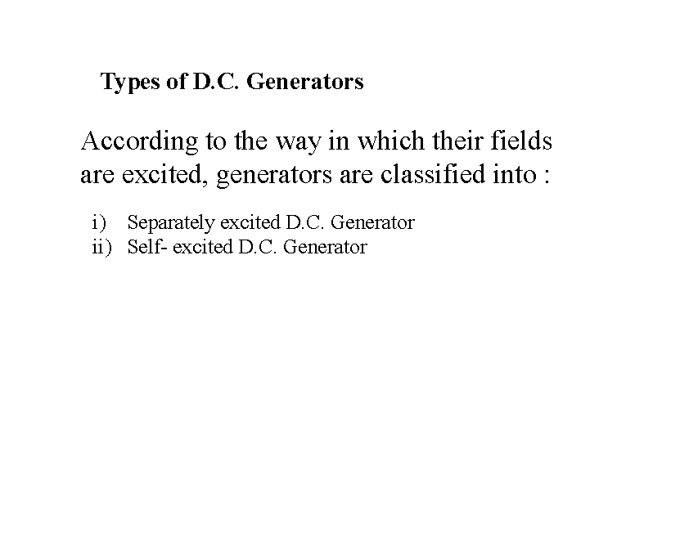

Slide 27
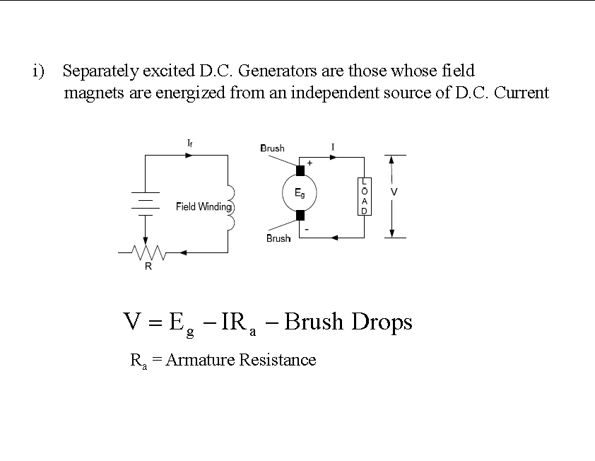

Slide 28
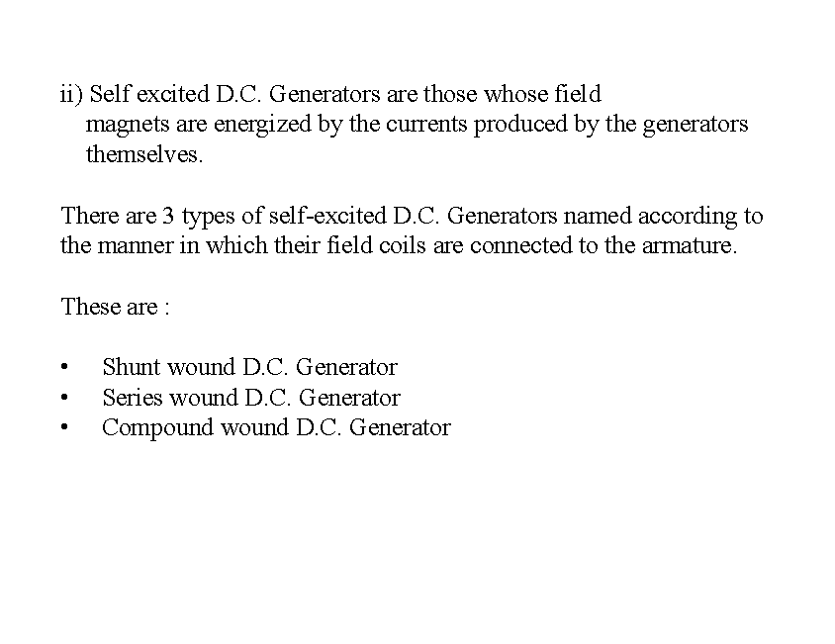

Slide 29
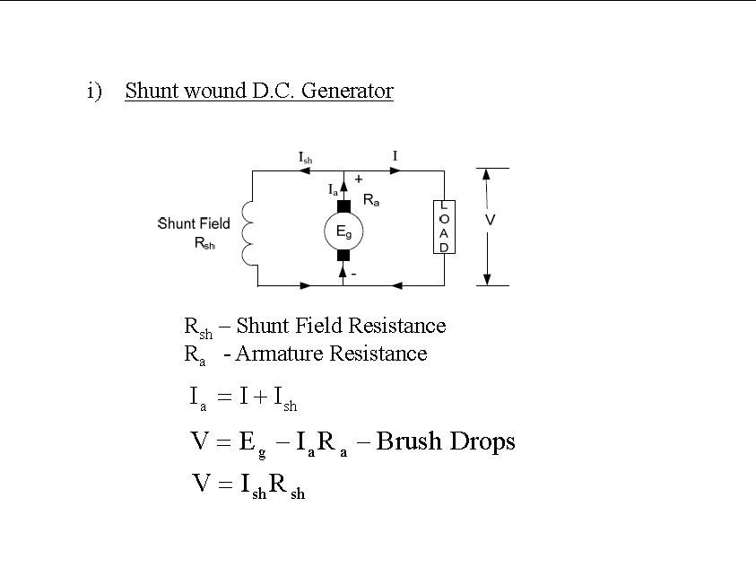

Slide 30
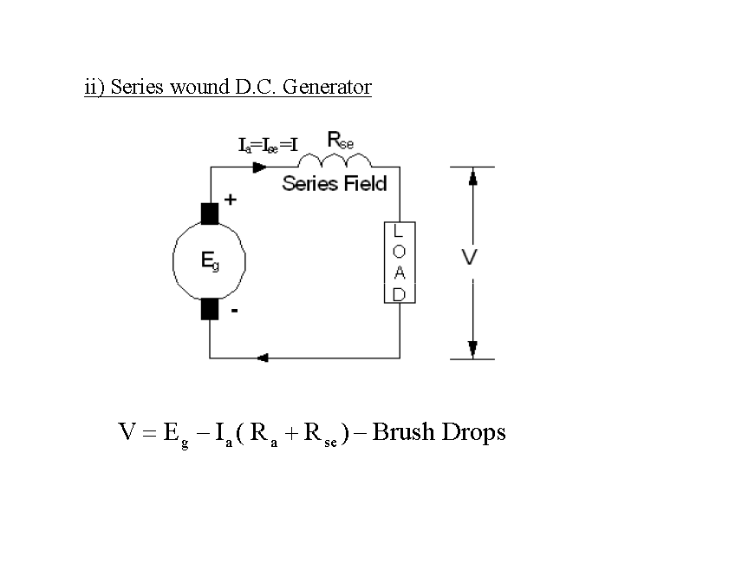

Slide 31
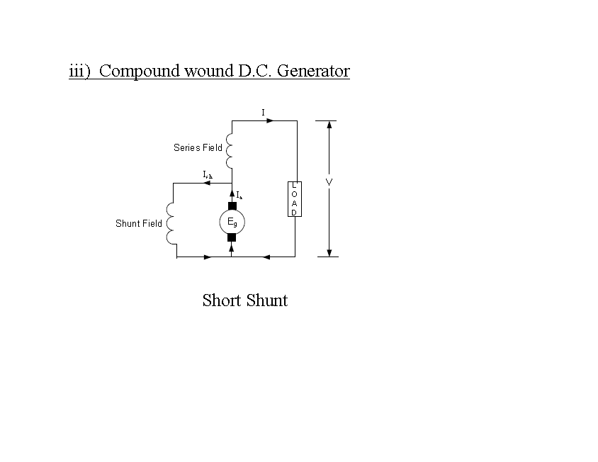

Slide 32
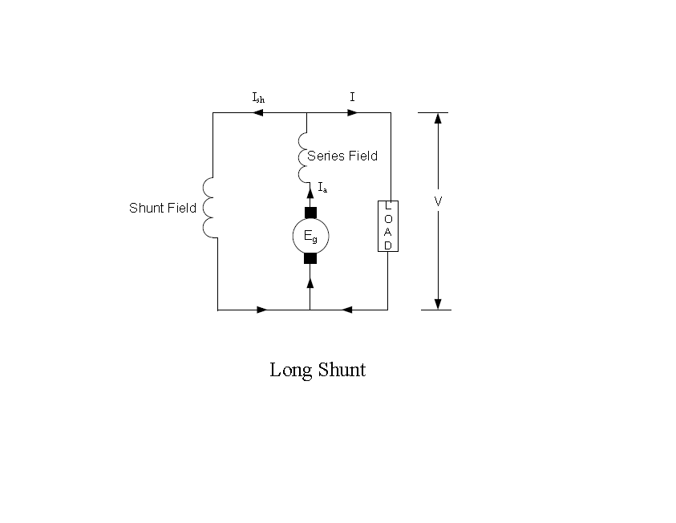

Slide 33
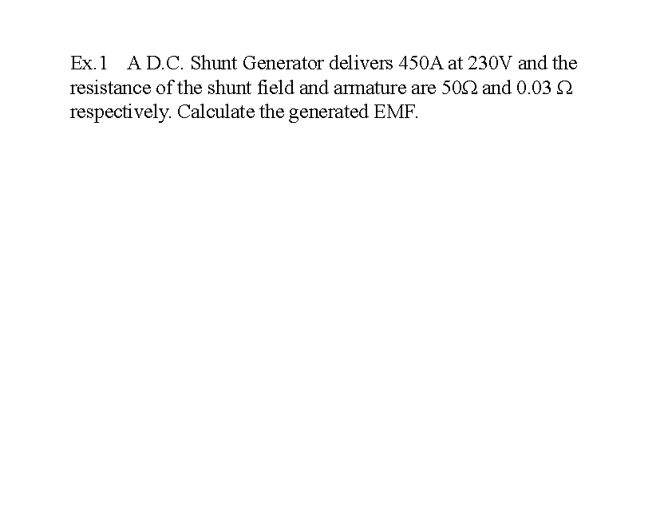

Slide 34
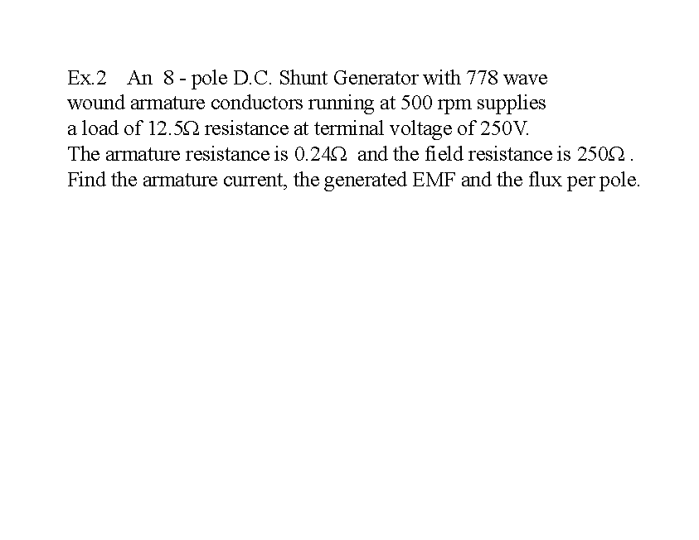

Slide 35
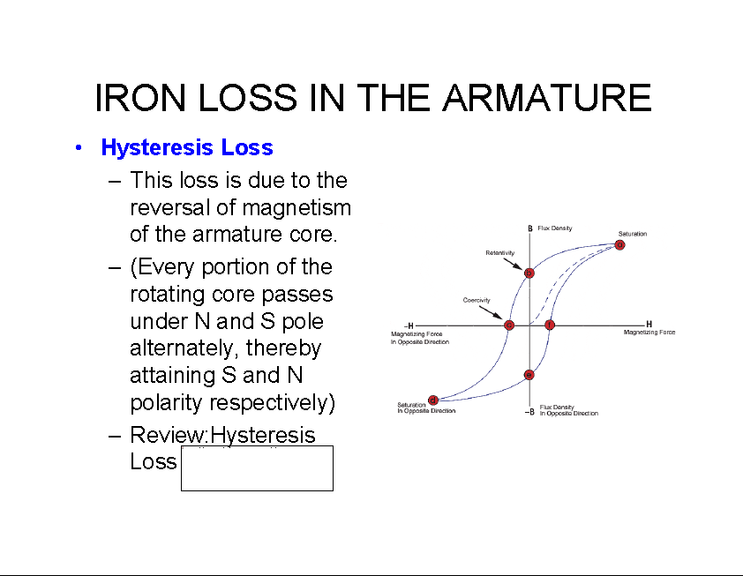

Slide 36
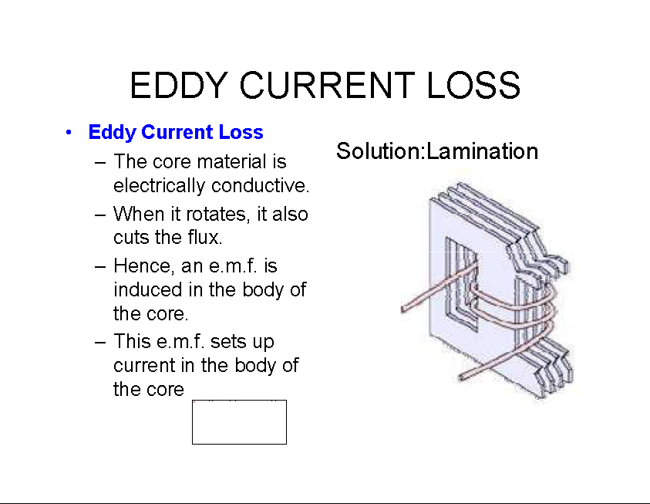

Slide 37
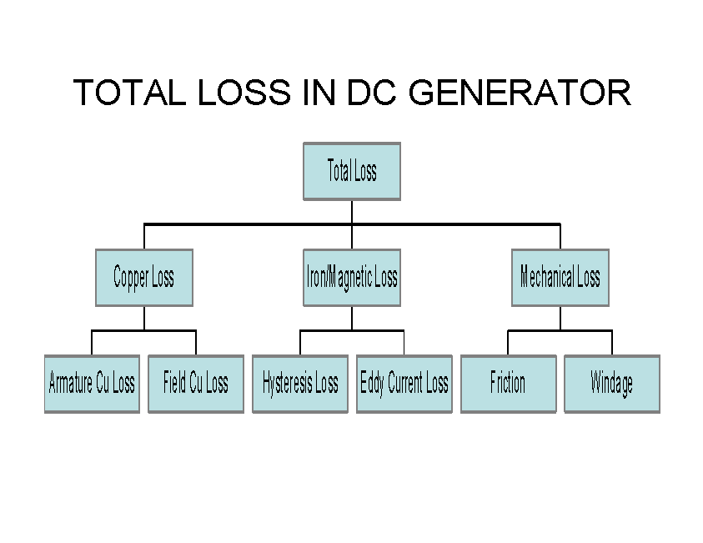

Slide 38
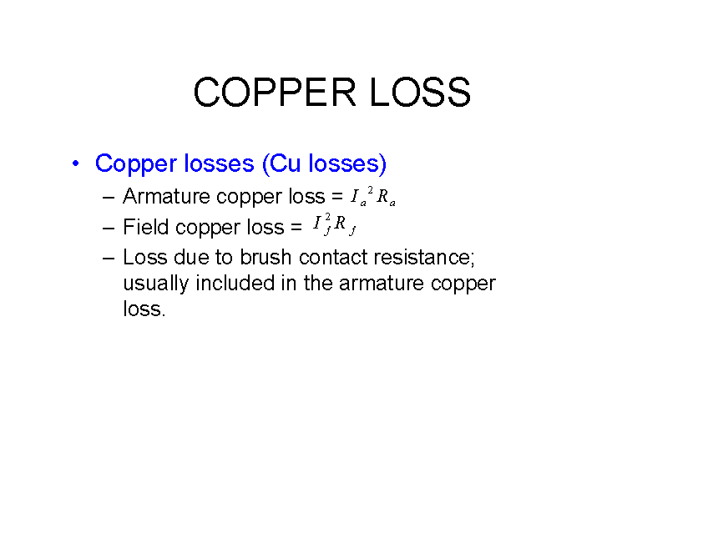

Slide 39
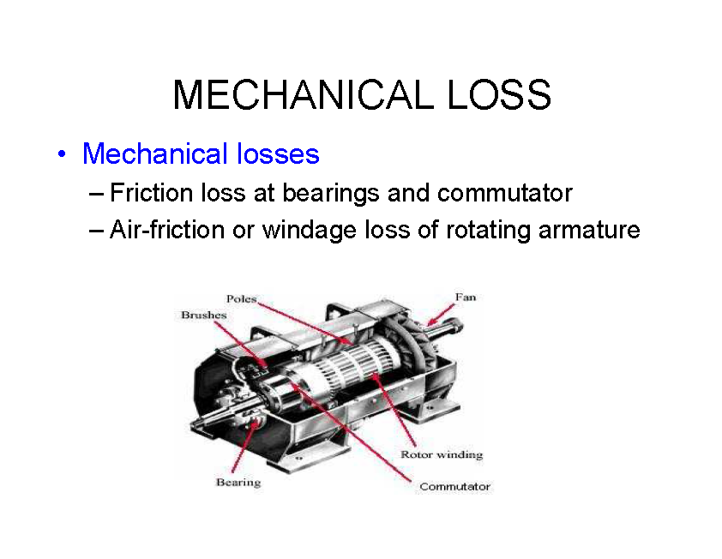

Slide 40
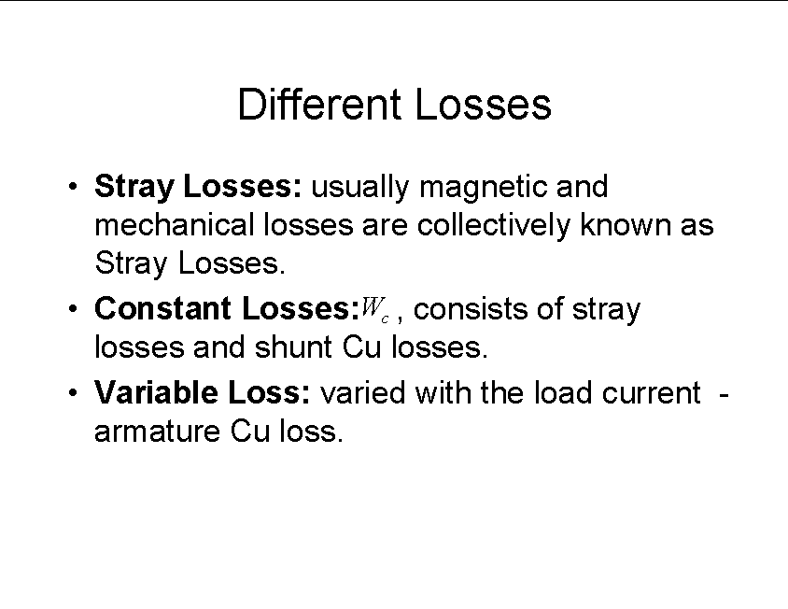

Slide 41
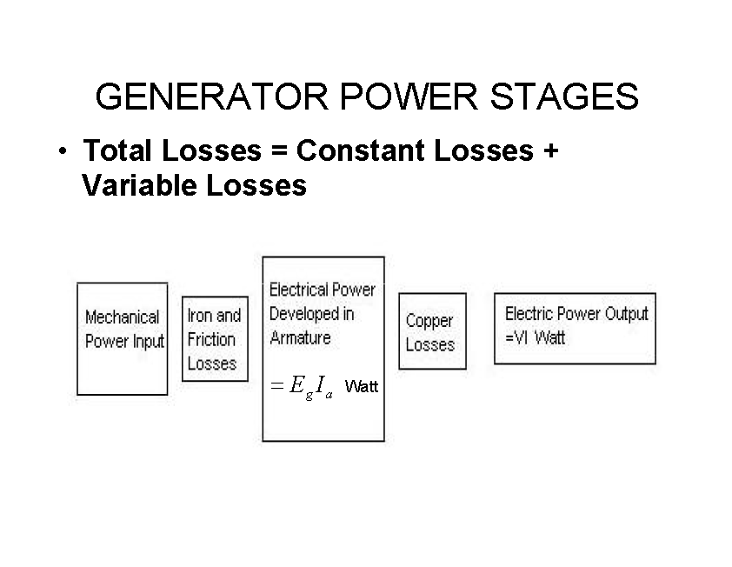

Slide 42
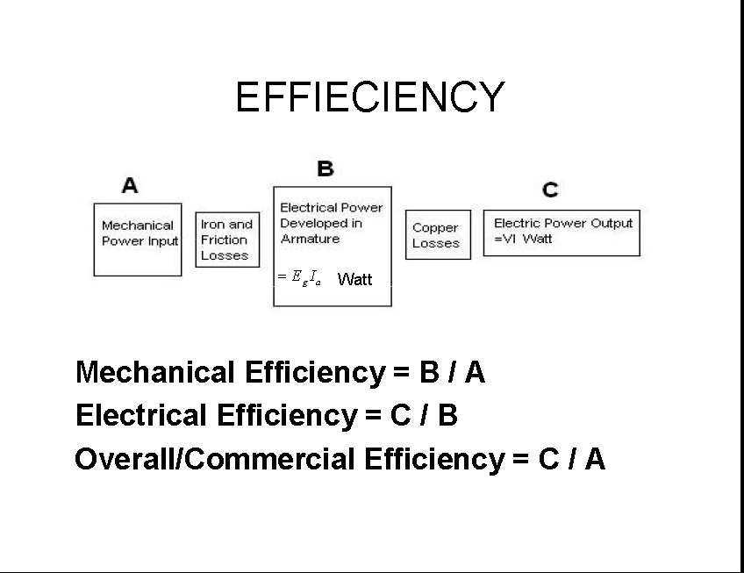

Slide 43
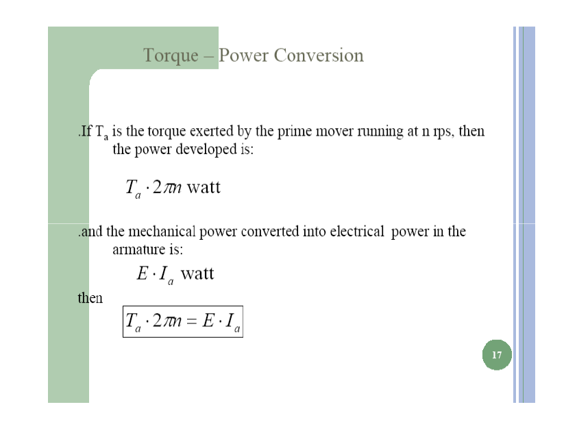

Slide 44
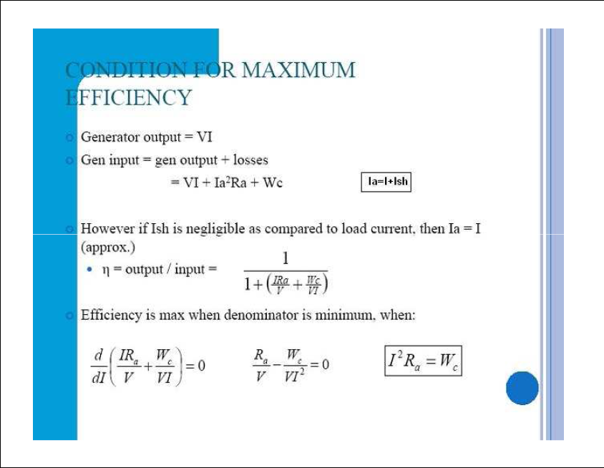

Slide 45
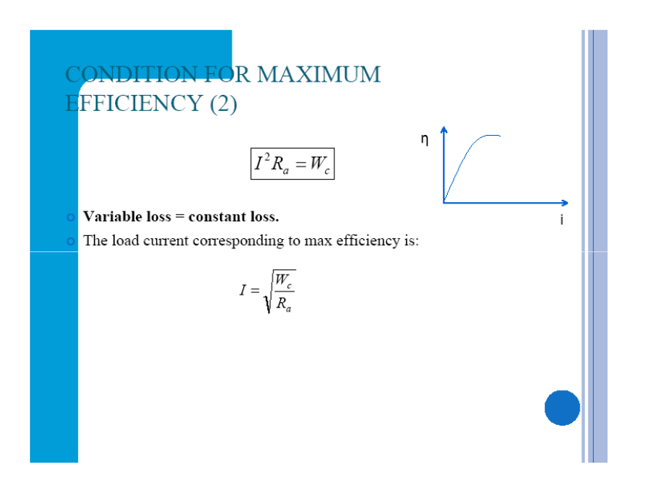

Slide 46
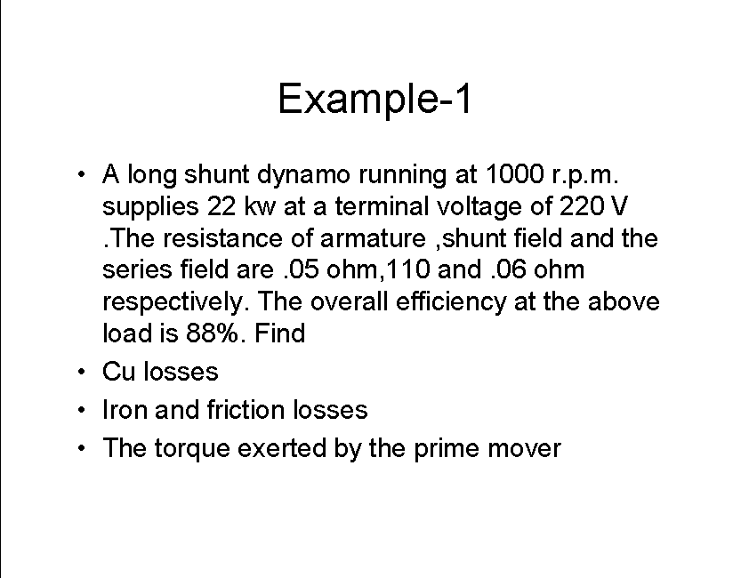

Slide 47
